Slide 1
SOLAR POWER GENERATION FORECAST
CH JAYANTH(521125)
MARK LAZARUS(521228)
G Chandra Sekhar(521137)

Slide 2
INTRODUCTION
Photo Voltaic Solar Power has emerged as the best source of green energy in recent past in a country like India which gets a good amount of solar insolation. With the continuous development of efficient PV modules, Battery storage and Smart Grid etc. Power Generation through PV Solar Plant has gained the momentum further and has a very promising future.
The solar power plant is also known as the Photovoltaic (PV) power plant. It is a large-scale PV plant designed to produce bulk electrical power from solar radiation. The solar power plant uses solar energy to produce electrical power. Therefore, it is a conventional power plant . Solar energy can be used directly to produce electrical energy using solar PV panels . Hence, to produce electrical power on a large scale, solar PV panels are used. Below is the layout plan of photovoltaic power plant.

Slide 3
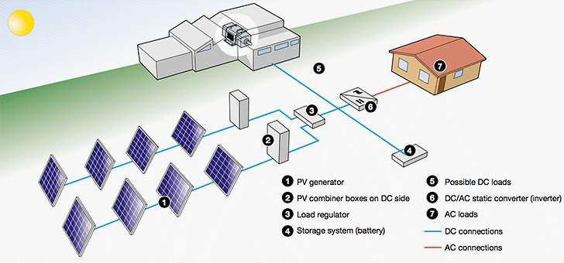
The above picture shows a typical structure of a solar power plant. Sunlight falls on PV modules, generates DC Power which is fed to the Inverters (through some Junction Box and String Monitoring Box), Inverters convert DC Power to AC Power, AC Power is stepped up through Transformers to match Grid Voltage and finally fed to the Grid through some Switchgear.

Slide 4
PROJECT DESCRIPTION
We have at hand solar power generation data and weather data of a solar plower plants. Let's explore the given data, draw some insights, try to meet our challenges and predict/forecast the plant output to the extent possible which can be used for a better Grid Management/Stability.
Utilizing machine learning techniques , this project aims to forecast the weather conditions of the upcoming days . Leveraging data collected from different dates in the year of 2020,the objective is to predict the solar energy produced and finding the error of the predicted solar energy collected from the solar panels.

Slide 5
methodology
Our proposed methodology involves exploring various machine learning algorithms to develop predictive models for detecting the radiant solar energy and find the prediction errors in those values . Initially, we experiment with different methods, including decision trees, random forests, support vector machines, and linear regression , random forest , decision tree classifier . Each method is evaluated based on its accuracy in predicting faults using the collected IoT data.
Following extensive experimentation and evaluation, we select the model with the highest accuracy for further refinement and optimization. This model demonstrates superior performance in identifying the onset of errors prediction , offering promising results for proactive maintenance strategies

Slide 6
DATA COLLECTION
The data was collected from different dates in may and June months of 2020 via IoT devices, with readings taken at different time intervals . The data is contained in two CSV files: “Plant_2_Weather_Sensor_Data" and “Plant_2_Generation_Data". The two Data frames were merged on the “DATE_TIME” column.
This dataset was originally collected from Kaggle at the following URL :
https://www.kaggle.com/datasets/pythonafroz/solar-power

Slide 7
Data anlysis
The features in the data include :
1. DATE AND TIME
2. DC POWER
3. AC POWER
4. AMBIENT TEMPERATURE
5. MODULE TEMPERATURE
6. IRRADIATION

Slide 8
Code part
We used the MOG_A feature as the output variable . The data was split into 80 % training and 20% testing sets for building a machine learning model.
GOOGLE COLAB link :
https://colab.research.google.com/drive/1gwK-5ANh3-yaZj-nbIZkV2ws-CnF2RM0?usp=sharing

Slide 9
result
After conducting experiments using various machine learning algorithms on the dataset collected from IoT devices, we obtained the following accuracies for predicting the solar radiation and ac power produced are as follows :
DECISION TREE : 100%
LINEAR REGRESSION : 99.9994%
RANDOM FOREST : 100%

Slide 10
Among these models, the Random Forest and decision tree algorithm demonstrated the highest accuracy of 100%. Consequently, we selected the Random Forest and decision tree model as the most effective approach for predicting the solar radiation . This high accuracy suggests that the Random Forest model is well-suited for identifying potential issues in distribution transformers and enabling proactive maintenance strategies
Notes:
Among these models, the Random Forest algorithm demonstrated the highest accuracy of 98.85%. Consequently, we selected the Random Forest model as the most effective approach for predicting magnetic faults in oil gauges. This high accuracy suggests that the Random Forest model is well-suited for identifying potential issues in distribution transformers and enabling proactive maintenance strategies

Slide 11
CONCLUSION
In conclusion, our study assessed machine learning algorithms for predicting the solar power yielded and error . The Random Forest and decision tree model yielded the highest accuracy at 100%, offering reliable fault detection. This underscores its suitability for proactive maintenance, ensuring uninterrupted power distribution. Our findings highlight the significance of advanced algorithms in infrastructure management. Future endeavors could refine models and integrate real-time monitoring. Overall, our research enhances predictive maintenance strategies, fostering resilience and efficiency in electrical power distribution systems.

Slide 12
THE END

